Slide 1
The disasters that define us
Placeholder for optional client logo
The disasters that influenced me and their lessons for all of us
Daniel Kaniewski, Ph.D.
Juvare Users Conference
January 10, 2025

Slide 2
9/11
Hurricane Katrina
Hurricane Maria
Covid-19
Lessons Learned
Disaster Resilience
Agenda
Notes:
Leading Resilience

Slide 3
9/11 – September 11, 2001
1
Notes:
FF/medic, BS EMS, MA National Security
Working on Capitol Hill
Since 1998 Gilmore Commission
Mentors like FDNY chief Ray Downey

Slide 4
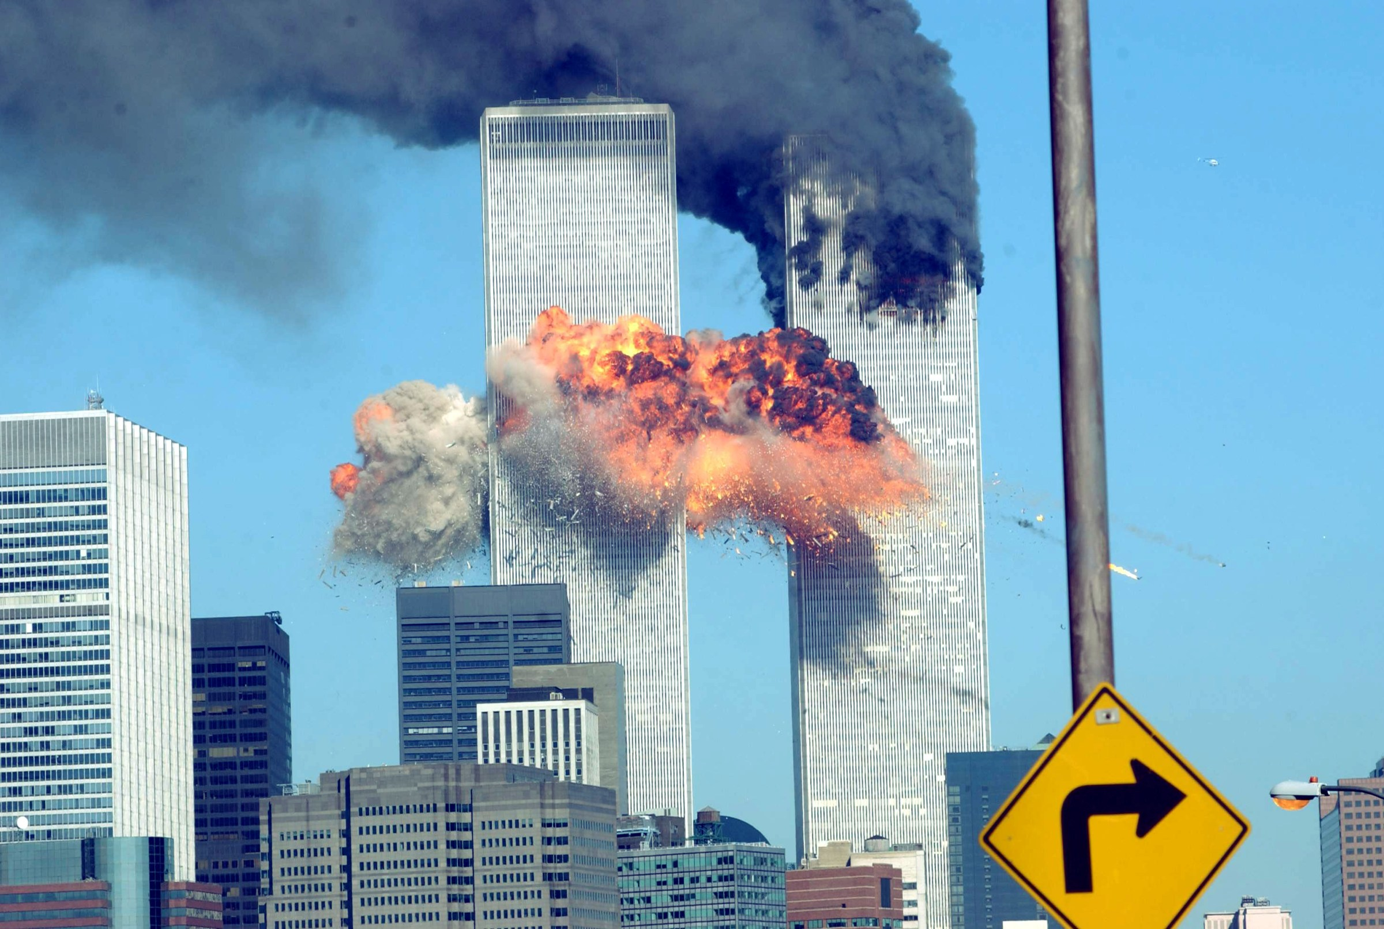
Notes:
Saw the images on TV
Tried calling my mentor Chief Downey
Found myself at the top of the Capitol Building after the two planes had struck the World Trade Center
Continued with the previously scheduled press conference in the Capitol press gallery
A fiery blasts rocks the World Trade Center after being hit by two planes September 11, 2001, in New York City. | Spencer Platt/Getty Images

Slide 5
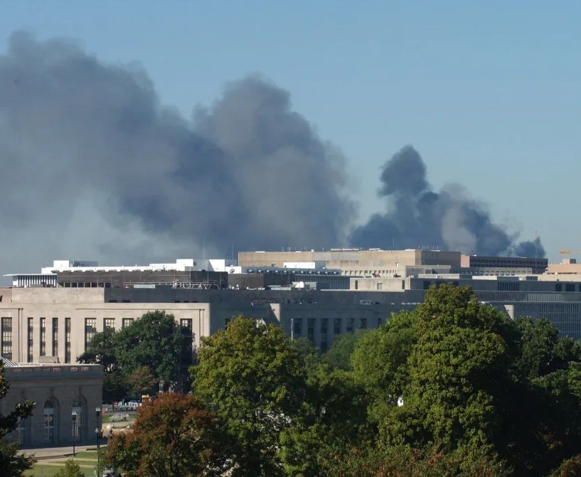
9/11 – U.S. Capitol
I found myself in the crosshairs of a terrorist attack
Smoke from the Pentagon, as seen from the West Front of the Capitol.
Notes:
CNN: truck bomb at the Pentagon
Realized America was under attack – and we weren’t safe
Evacuated the building and owed my life to the brave souls aboard Flight 93
(Douglas Graham/CQ Roll Call File Photo)

Slide 6
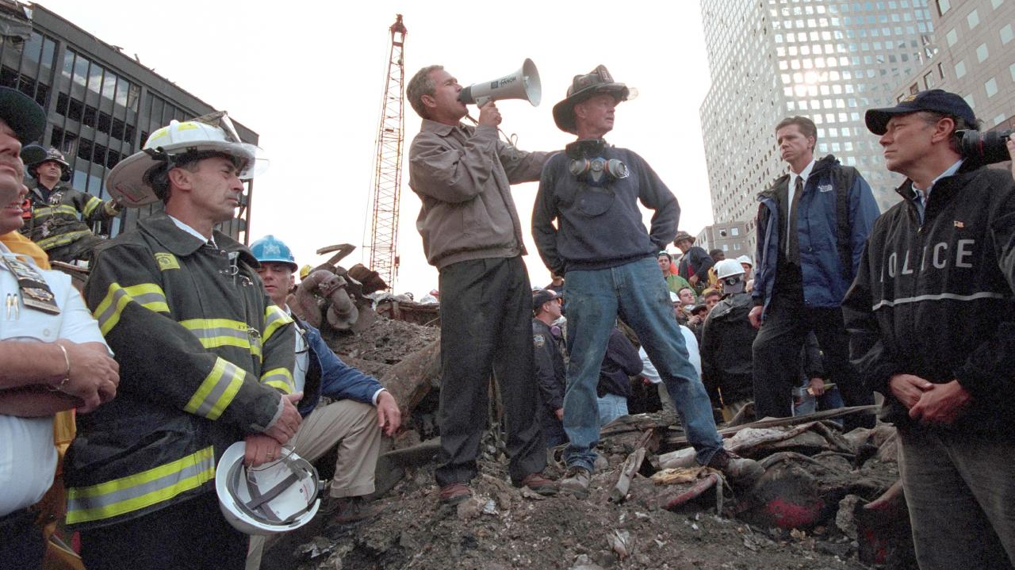
Notes:
Took first train to NYC on September 14
Went to Ground Zero and met FEMA Administrator Joe Allbaugh
Sent to Javits Center where the President would meet with first responder families

Slide 7
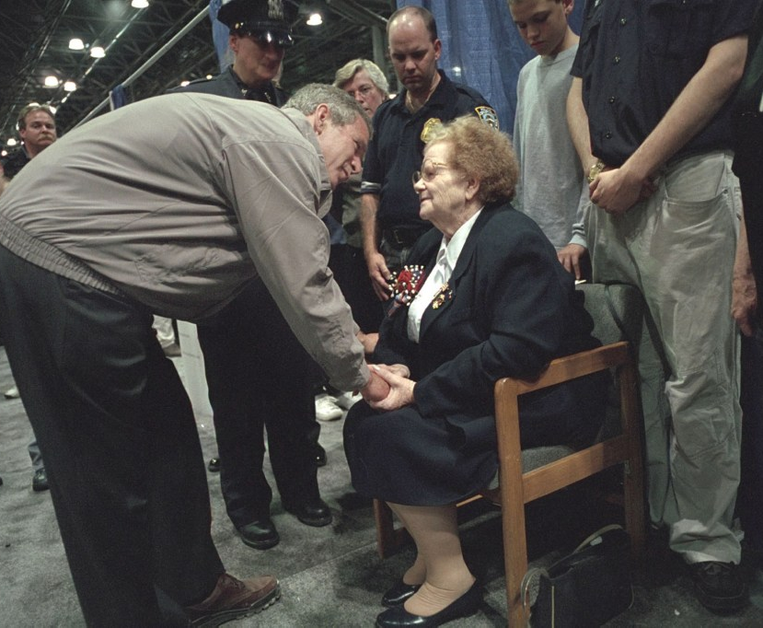
9/11 – NYC
September 14, 2021
President Bush, left, talks with Arlene Howard, seated right, after Howard presented a police badge found on the body of her son, Port Authority Police officer George Howard, to President Bush as he greeted family members of victims in the World Trade Center attacks on Sept. 14, 2001, in New York.
Notes:
Helped Arlene Howard and witnessed her handing her son’s badge to President Bush

Slide 8
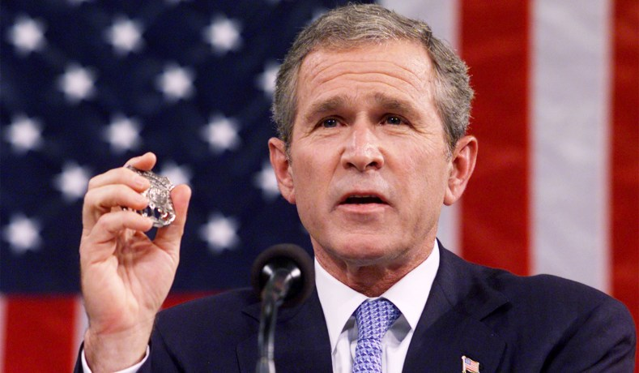
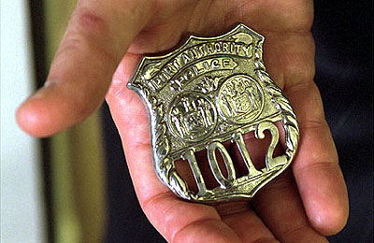
President George W. Bush holds the shield of police officer George Howard while addressing a joint session of Congress, September 20, 2001.
President Bush holds the badge of a police officer killed in the September attacks. "And I will carry this," said President Bush during his address to Congress Sept. 20. "It is the police shield of a man named George Howard, who died at the World Trade Center trying to save others... It is a reminder of lives that ended, and a task that does not end.“
Notes:
September 20 joint session of Congress
(Win McNamee/Reuters)

Slide 9
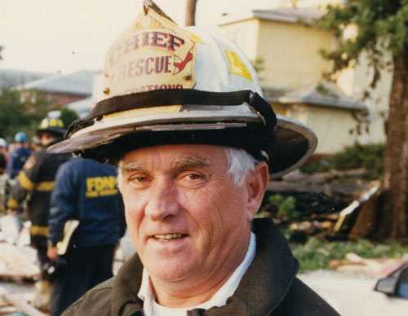
Reflection
My mentor’s lasting influence
Reflection: I had chosen the right career path and would dedicate my life to protecting Americans from man-made and natural disasters.
My mentor, FDNY Deputy Chief Ray Downey, pictured here at the scene of an explosion in Queens in 1996, died rescuing people from the World Trade Center on 9/11.
Notes:
(Photo courtesy of Downey family.)

Slide 10
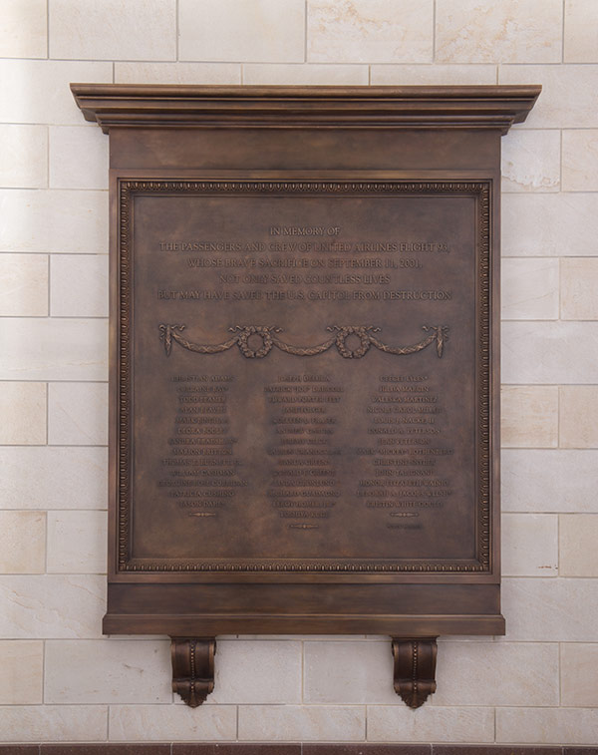
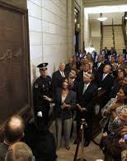
Capitol memorial
Flight 93 plaque
In memory of the passengers and crew of United Airlines Flight 93, whose brave sacrifice on September 11, 2001, not only saved countless lives but may have saved the U.S. Capitol from destruction
Notes:
The plaque hangs in the East Front Vestibule near the Capitol Rotunda. On September 9, 2009, it was unveiled during a small ceremony for Members of Congress and families of the passengers and crew. A larger anniversary memorial took place later that day in National Statuary Hall.
As directed by the commissioning resolution, the text of the plaque includes the names of the passengers and crew of Flight 93
https://www.aoc.gov/explore-capitol-campus/art/flight-93-memorial-plaque

Slide 11
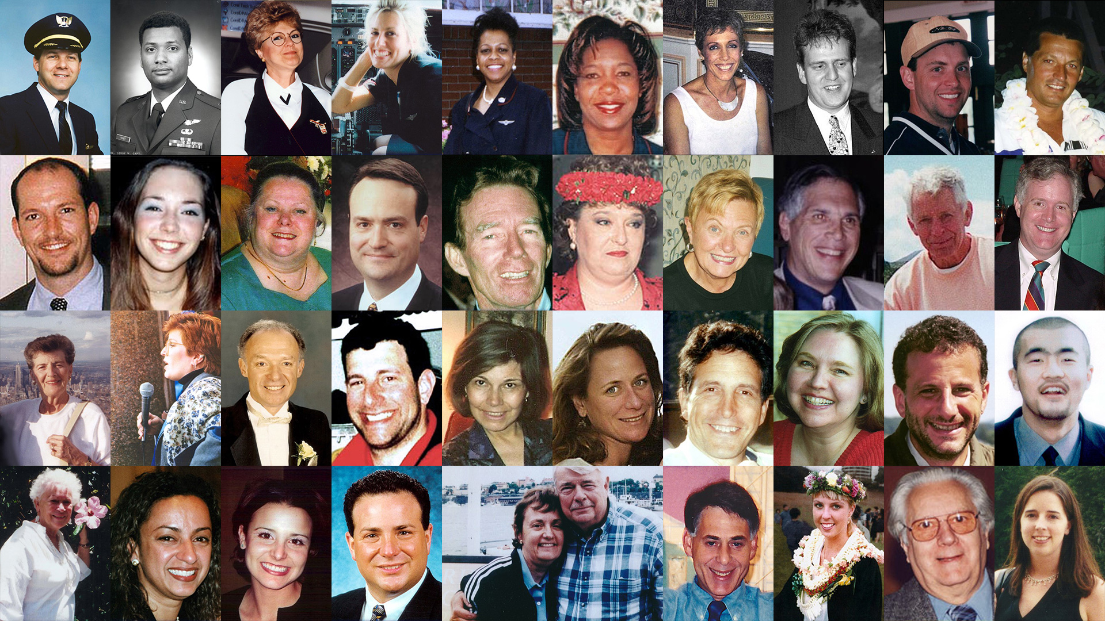
Notes:
Photos of the crew and passengers aboard United Airlines Flight 93 on Sept. 11, 2001. (Credit: NPS)

Slide 12
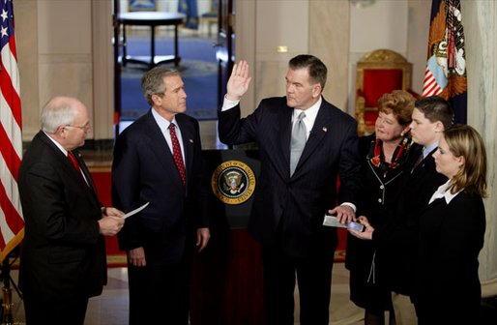
Policy Action: U.S. Department of Homeland Security
Created by the Homeland Security Act of 2002
Governor Tom Ridge sworn in as the Secretary of the Department of Homeland Security in the Cross Hall Jan. 24, 2003. Secretary Ridge's wife, Michele, and children, Tom and Lesley, hold the Bible during the administering of the oath. "In October of 2001, when I established the office -- the White House Office of Homeland Security -- I knew immediately that Tom was the right man for the assignment. He's a decisive, clear-thinking executive who knows how to solve problems. He's a person of integrity and a person of good judgment," said the President in his remarks.
Notes:
https://georgewbush-whitehouse.archives.gov/news/releases/2003/01/images/20030124-5_d012403-515h.html
(White House photo by Paul Morse )

Slide 13
Hurricane Katrina – August 2005
2

Slide 14
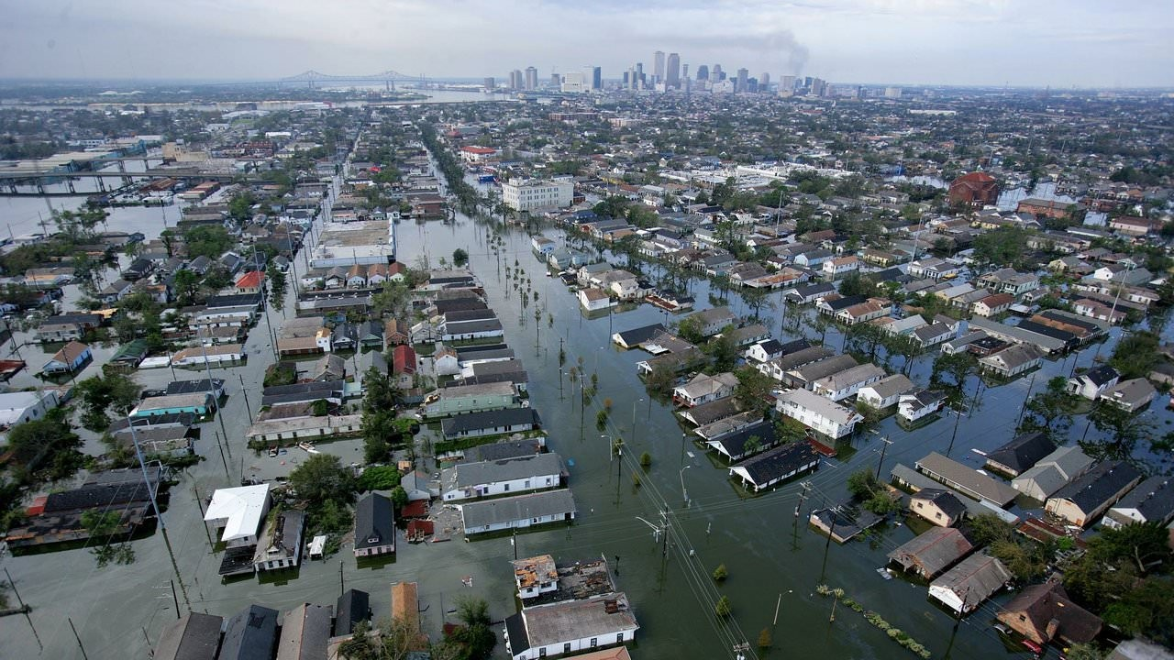
Notes:
Joined the White House staff a few weeks before the hurricane struck the Gulf Coast
Produced situation reports (Sit Reps) to keep the White House staff updated
Witnessed the devastating impact and recovery
Floodwaters from Hurricane Katrina cover streets on Aug. 30, 2005, in New Orleans. (Vincent Laforet/AFP/Getty Images)

Slide 15
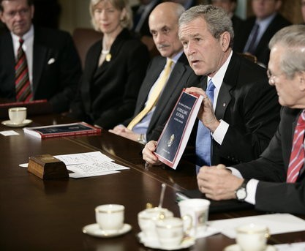
Hurricane Katrina – August 2005
Lessons learned
President George W. Bush holds a copy of the newly released report, The Federal Response to Hurricane Katrina: Lessons Learned, while talking to reporters at a Cabinet meeting Thursday, Feb. 23, 2006 at the White House. The report reviews the federal response to Katrina and makes recommendations about how to better respond in the future.
Notes:
An editor for the after-action report on the federal response to Hurricane Katrina
Literally wrote the chapters on the response
(White House photo by Eric Draper.)

Slide 16
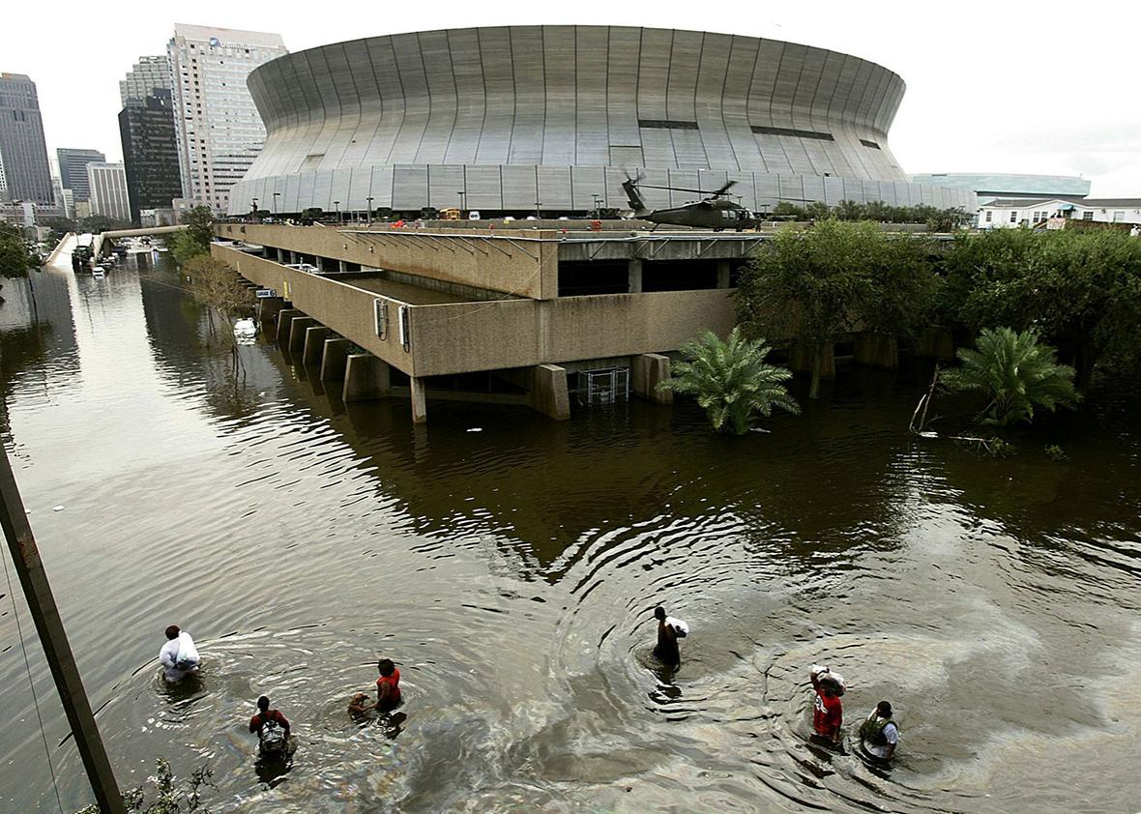
Reflection
At the helm at the White House
Reflection: My first disaster remains the most deadly and costly disaster of our time. Seeing first-hand the challenges the federal government faced taught me (and many of those around me, including President Bush) that we cannot repeat the failures of Katrina.

Slide 17
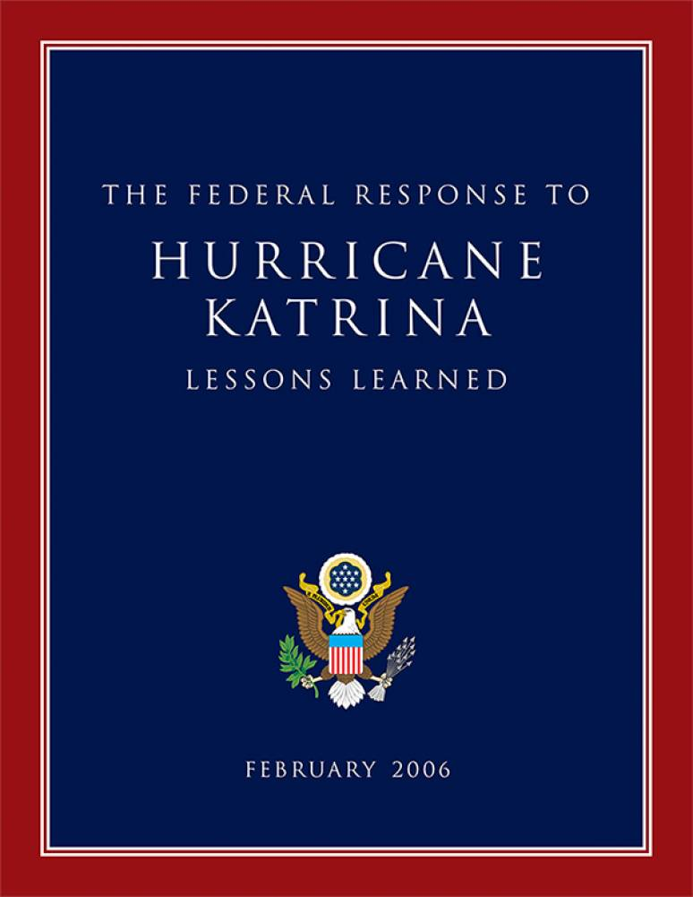
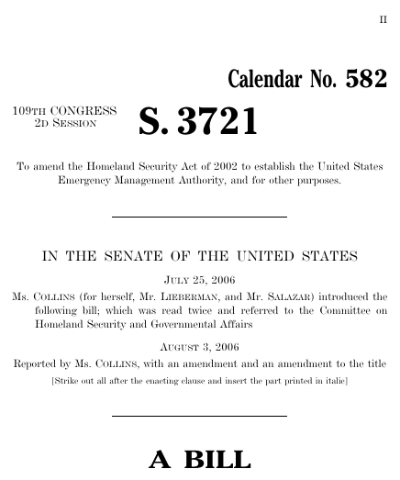
Policy actions
The Federal Response to Hurricane Katrina: Lessons Learned and the Post-Katrina Emergency Management Reform Act of 2006
Notes:
Emphasized “Culture of Preparedness”
PKEMRA moved preparedness programs to FEMA
Empowered FEMA and FEMA Administrator

Slide 18
Hurricane Maria – September 2017
3

Slide 19
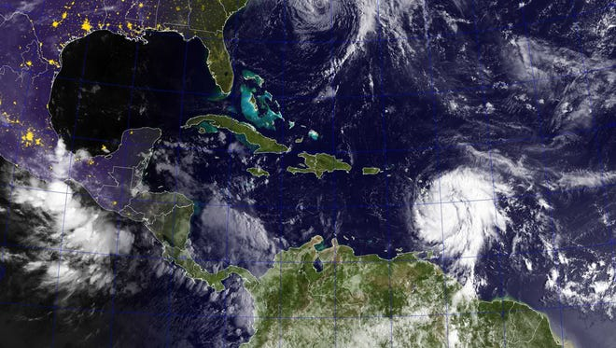
Notes:
Nominated to serve as a FEMA deputy administrator for resilience
Hearing during Hurricane Irma
Arrived at FEMA headquarters with visitor’s badge on Saturday with the formation of Tropical Storm Maria
3 weeks before Katrina, 3 days before Maria

Slide 20
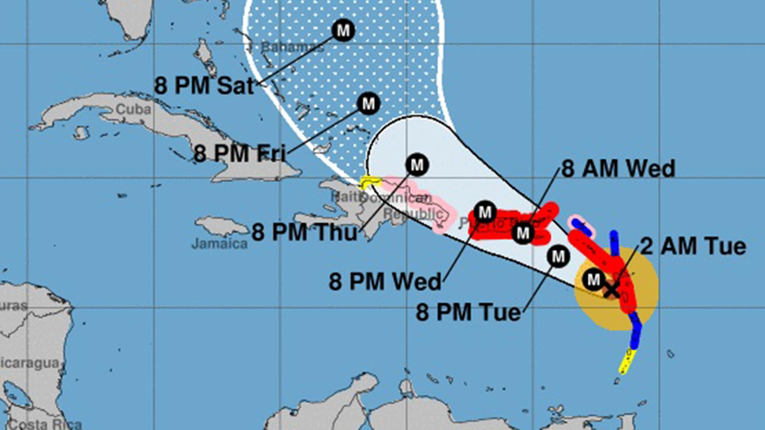
Notes:
The forecast path of Hurricane Maria (National Hurricane Center)
Became an official FEMA employee on Weds (landfall)
Experienced the intense months of response and recovery

Slide 21
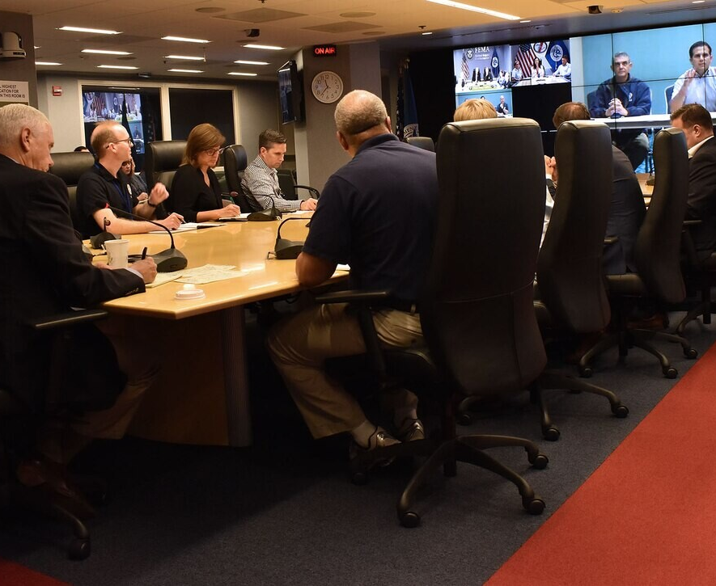
Hurricane Maria – September 2017
Twice daily VTCs
Vice President Mike Pence receives an update from Puerto Rico Gov. Ricardo Rossello about the response and recovery efforts underway after Hurricane Maria at the Federal Emergency Management Agency Headquarters in Washington, D.C., Sept. 30, 2017.
Notes:
Chaired VTCs, unless bumped…by the VP
(FEMA photo by Raymond Piper.)

Slide 22
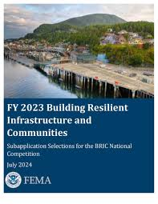
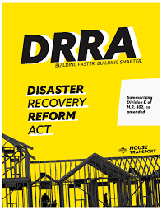
Policy Actions and reflection
FEMA must shift from response/recovery to resilience
Reflection: As a result of Hurricane Maria, the subsequent policy changes, and our concerted efforts to reduce the consequences of future disasters, FEMA began to shake its legacy role as the federal government’s first responder and instead became the government's disaster resilience agency.
Notes:
Advocated for a pre-disaster hazard mitigation program, leading to the inclusion of the BRIC program

Slide 23
Covid-19 – January 27, 2020
4

Slide 24
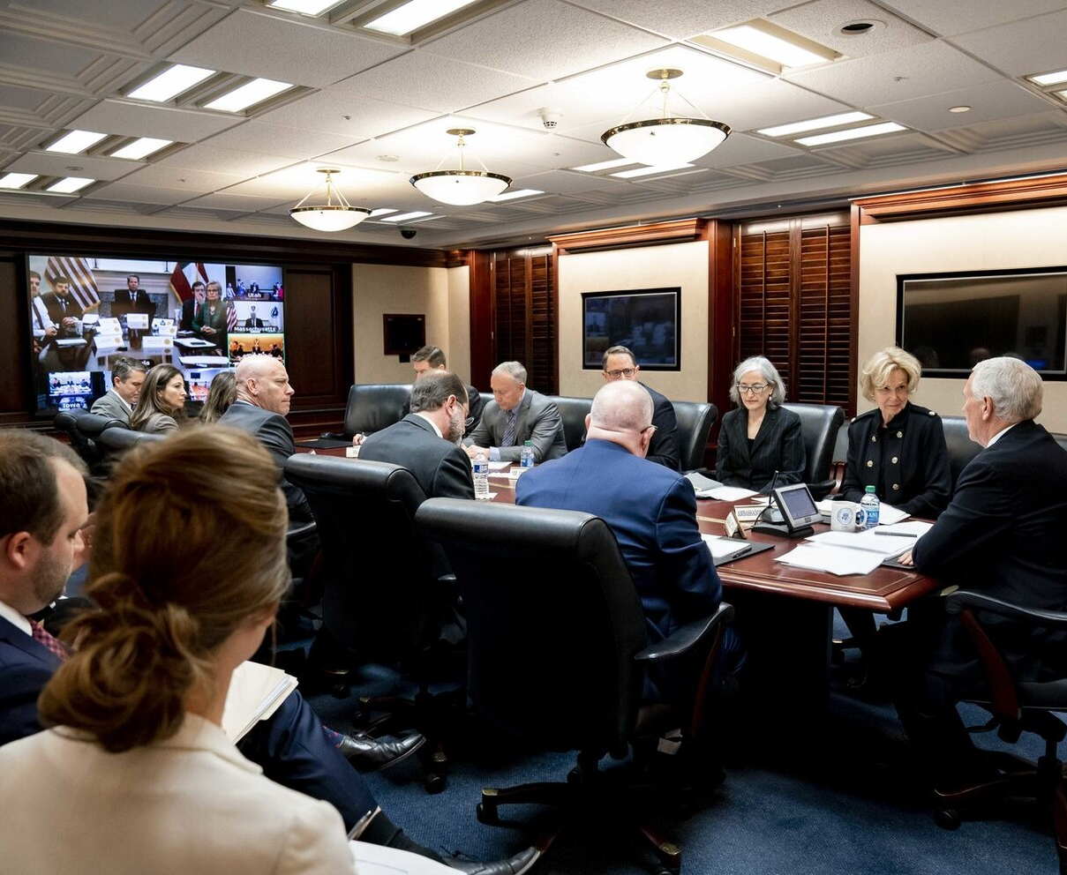
Covid-19 – January 27, 2020
White House Situation Room
Vice President Mike Pence meets the White House Coronavirus Task Force Principals Monday, March 2, 2020, in the White House Situation Room.
Notes:
Was chairing the FEMA senior leadership meeting
Interrupted by WH saying there was an WH meeting discussing travel restrictions
Joined a meeting in the White House Situation Room on the novel coronavirus
Witnessed the challenging interagency response and lack of coordination
No mention of NRF, FEMA’s role, ESF-8, etc.
(Official White House Photo by Andrea Hanks)

Slide 25
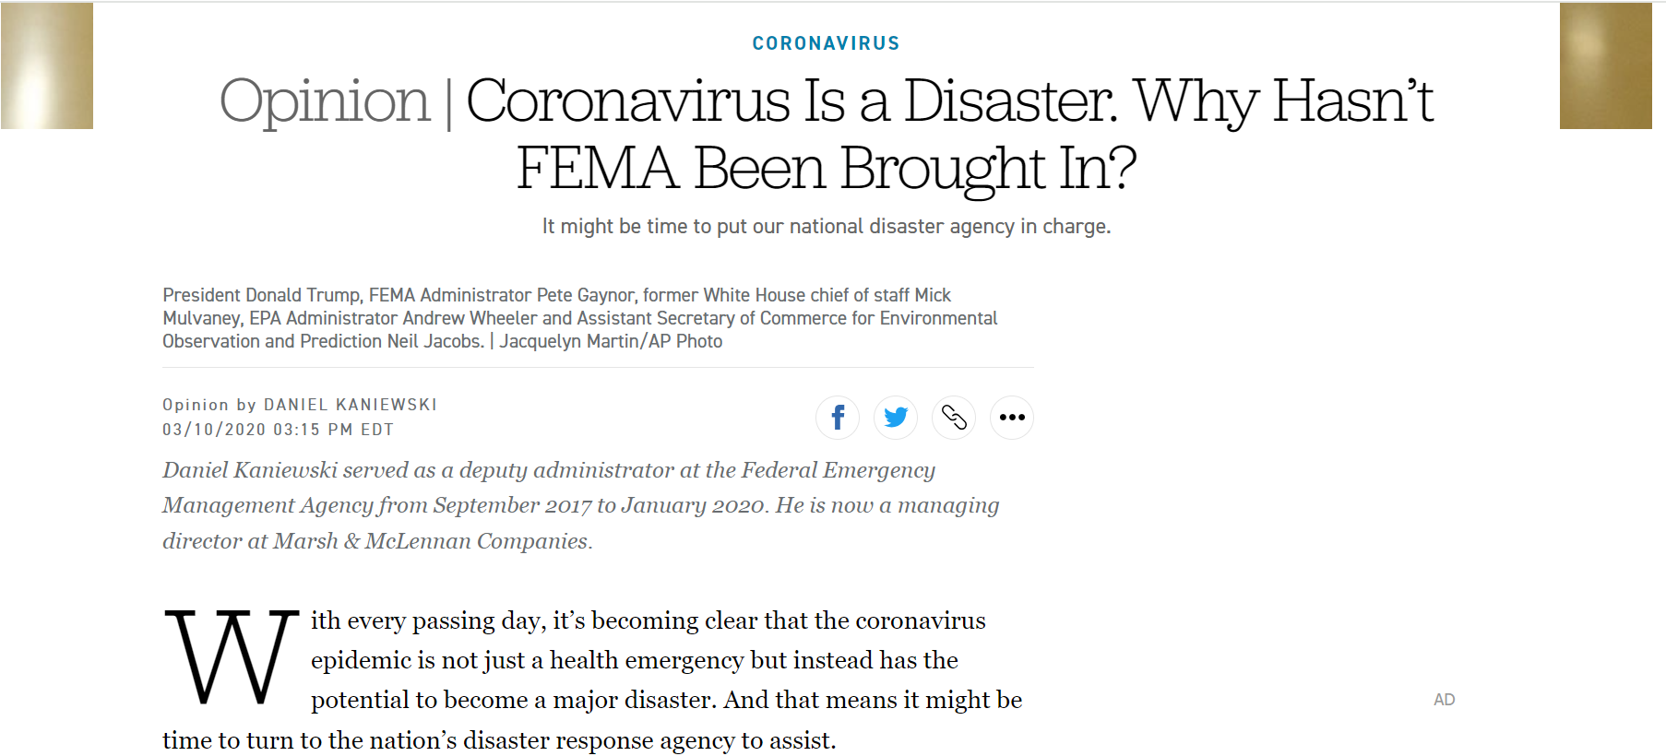
https://www.politico.com/news/agenda/2020/03/10/coronavirus-crisis-fema-125076
Notes:
Advocated for FEMA to lead the response

Slide 26
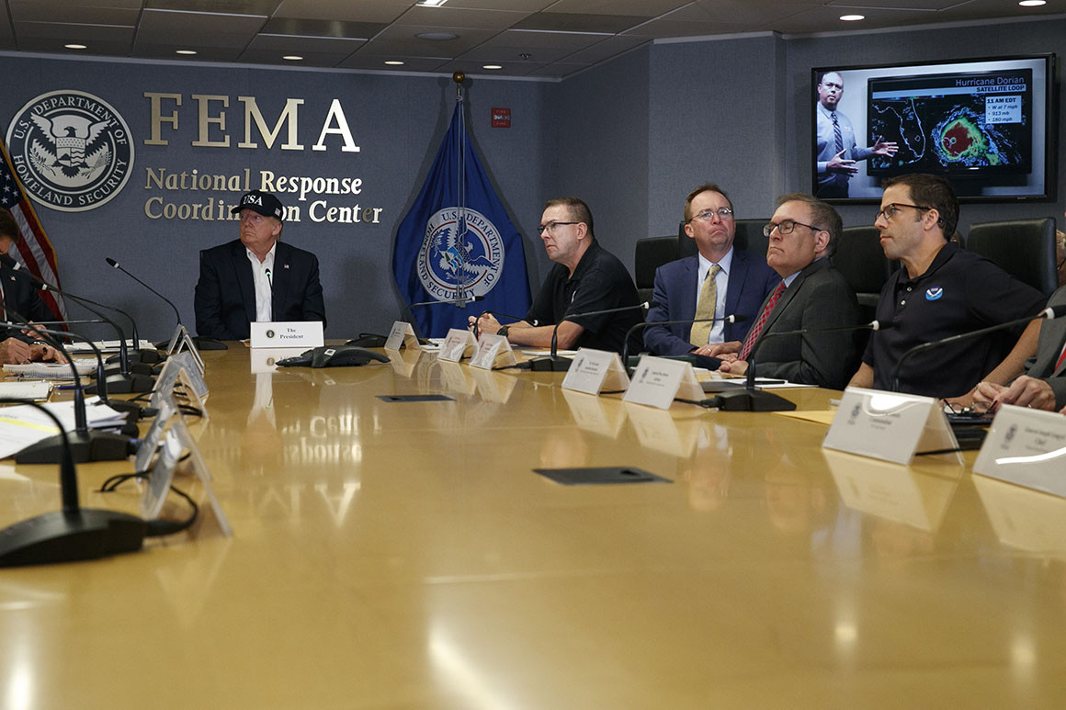
Reflection
FEMA is the nation’s all-hazards agency
Reflection: Covid demonstrated the value of emergency management’s “all hazards” approach. An emergency manager is the Swiss Army knife of crisis management. We, as emergency managers, should expect to step up and lead whenever a major emerges, regardless of whether it’s a “traditional” disaster or not—for example, a cyber-attack with physical consequences.

Slide 27
Lessons learned
5

Slide 28
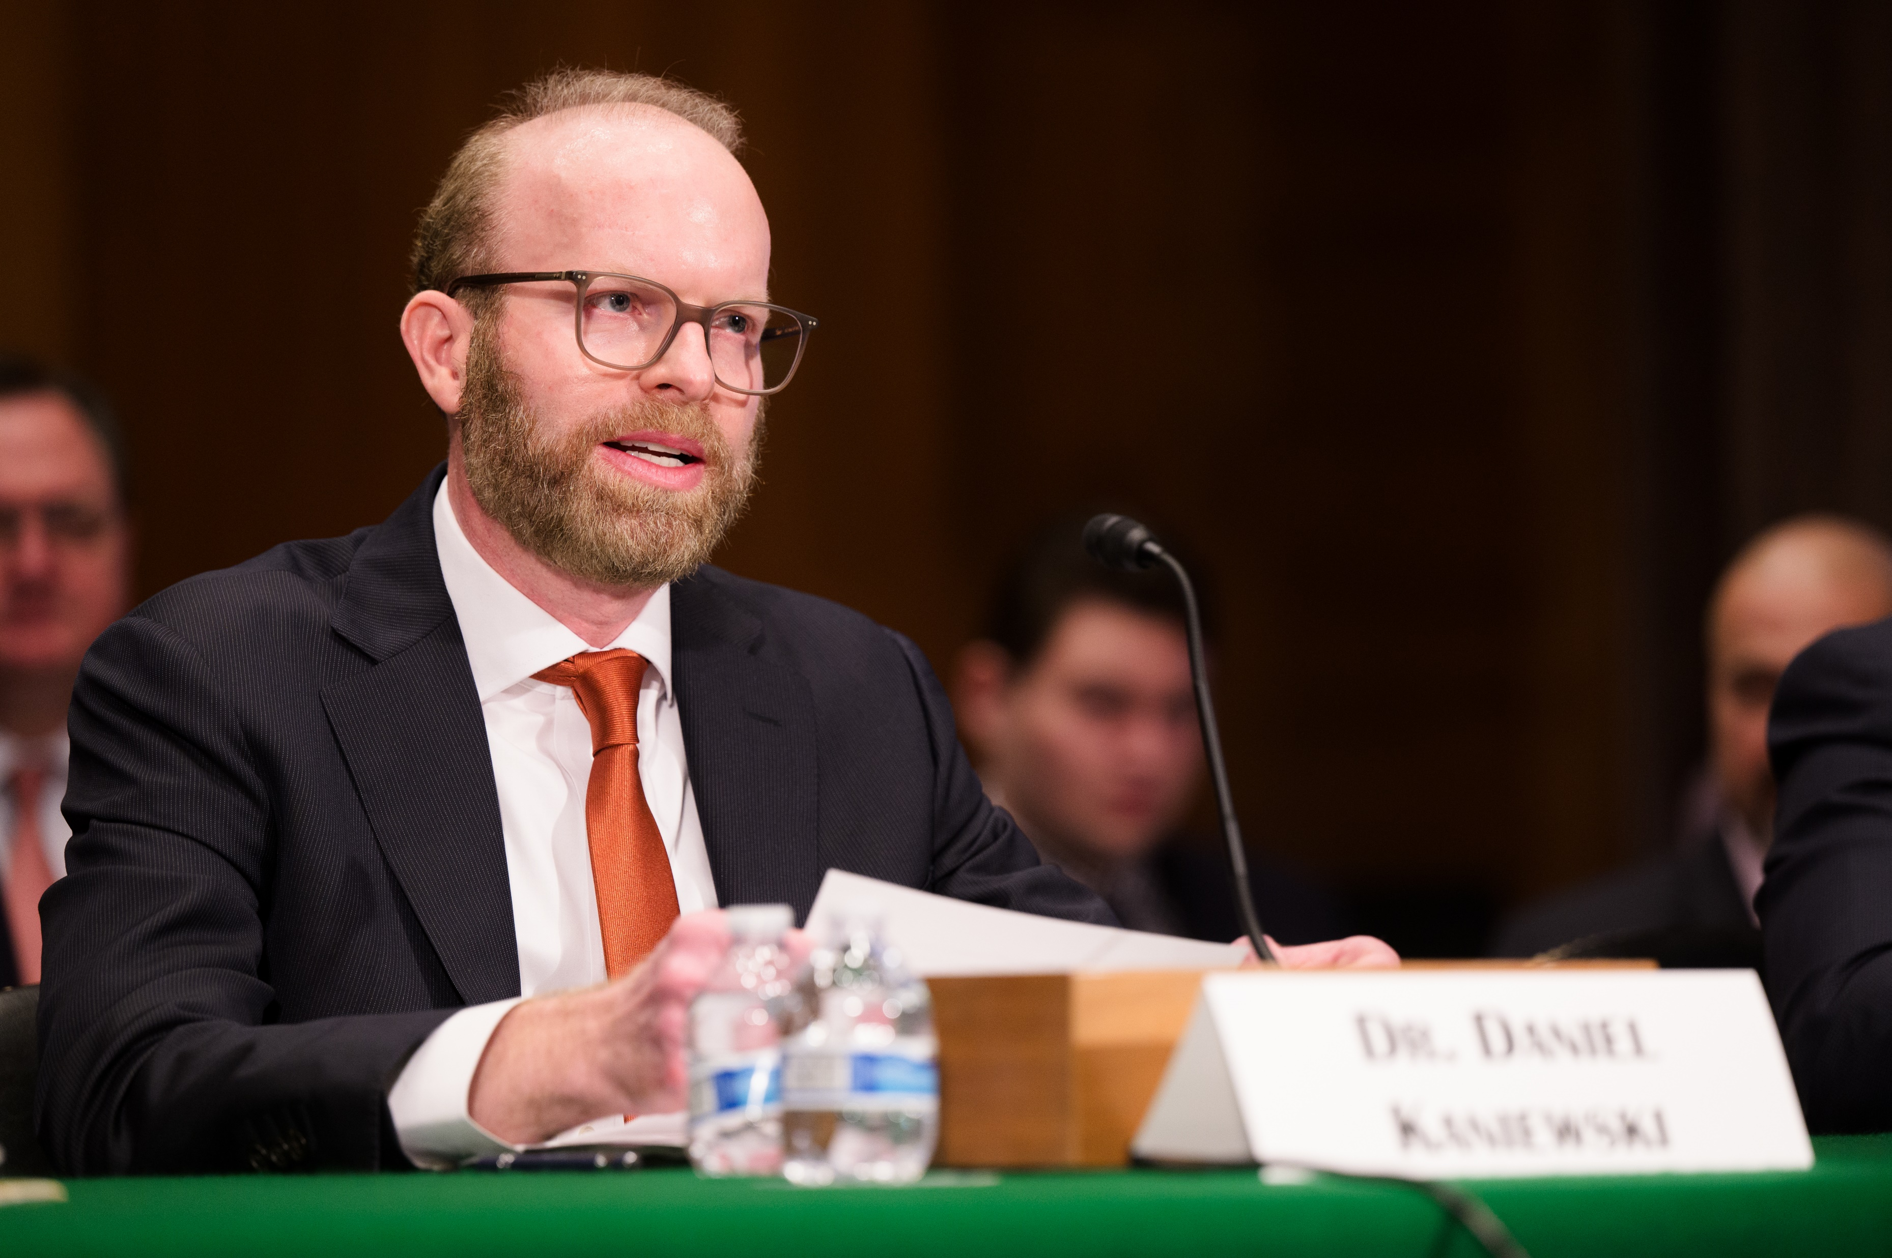
Lessons learned: Personal
What these disasters taught me
Chosen the right career path and would dedicate my life to protecting Americans from disasters.
Learned the importance of effective communication and response in the face of a crisis
Realized the need for policy changes and efforts to reduce the consequences of future disasters
Recognized the value of emergency management's 'all hazards' approach

Slide 29
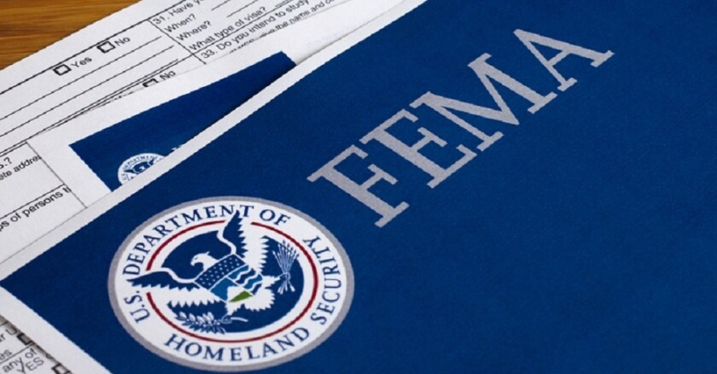
Lessons learned: Policy actions
Policymakers acted following 9/11, Katrina, and Maria
Homeland Security Act of 2002 (created DHS)
Post-Katrina Emergency Management Reform Act of 2006 (re-organized FEMA/DHS)
Disaster Recovery Reform Act of 2018 (BRIC)

Slide 30
Disaster Resilience
6

Slide 31
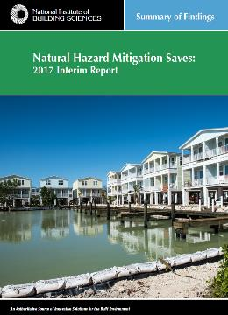
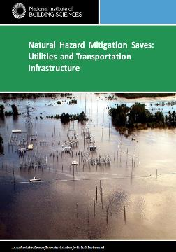
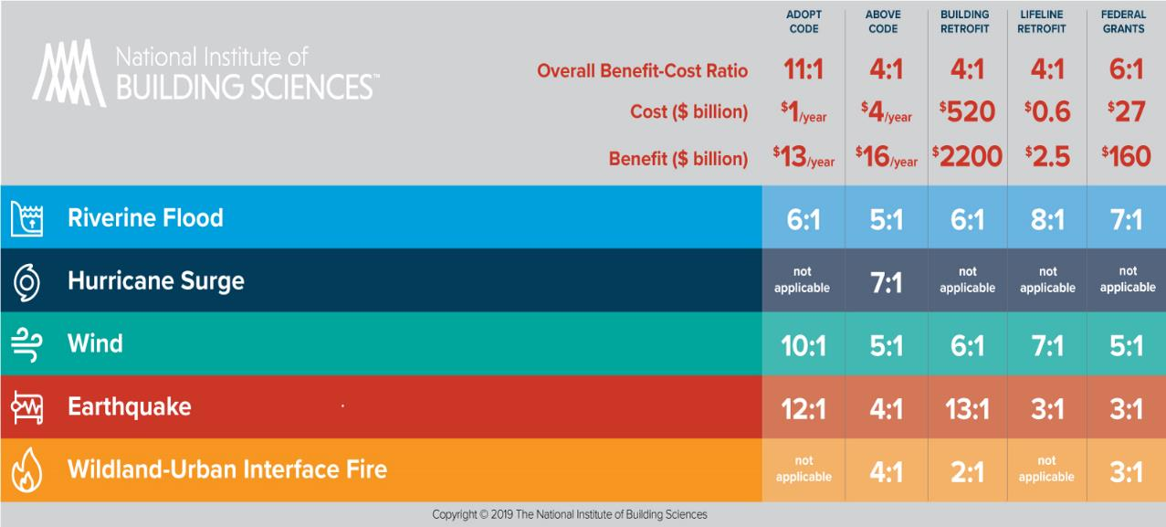
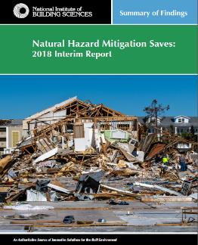
Benefits of Hazard Mitigation
NIBS found 6:1 Benefit Cost Ratio
Natural Hazard Mitigation Saves

Slide 32
Recent Stafford Act amendments
FEMA can leverage its authorities to incentivize resilience
Community Disaster Resilience Zones
  FEMA has designated communities most in need of hazard mitigation assistance, as identified by a risk analysis tool that considers such factors as social vulnerability, natural hazards loss exposures, and lack of resilience.
  CDRZ-designated communities are eligible for technical assistance and an increased federal share for BRIC grants, up to 90% (from the current 75%).
FEMA Public Assistance incentive measures
  The President may provide incentives to a State or Tribal government to invest in measures that increase readiness for, and resilience from, a major disaster by recognizing such investments through a sliding scale that increases the minimum Federal share to 85 percent.
  See: https://www.nibs.org/blog/disaster-resilience-trillion-dollar-challenge-heres-what-fema-can-do-help

Slide 33
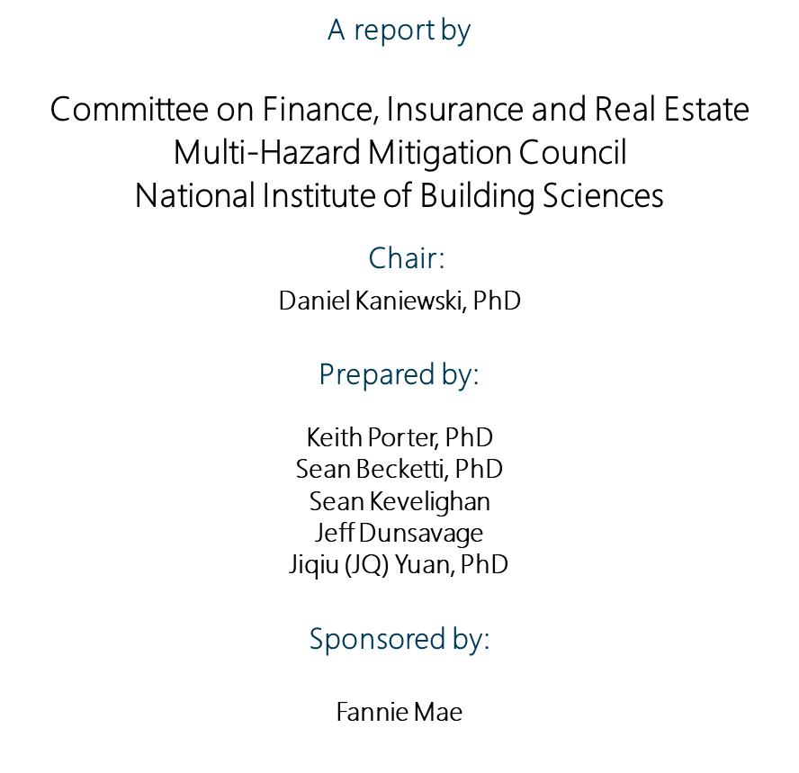
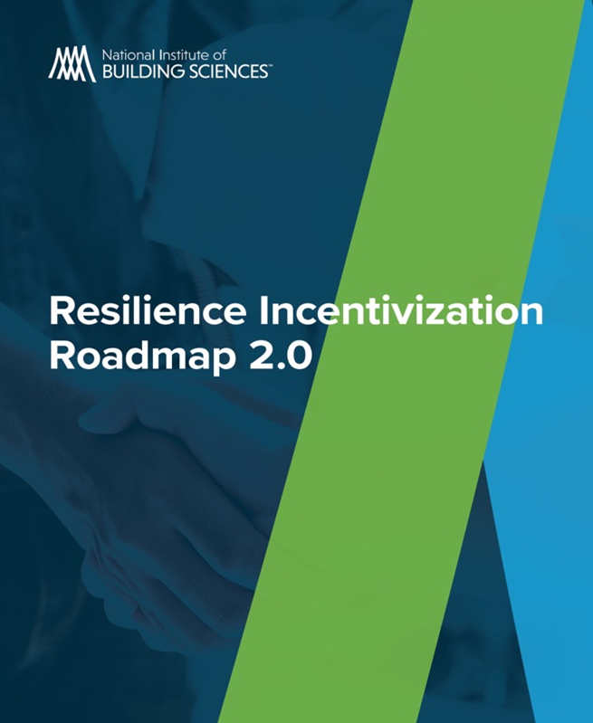
Resilience Incentivization Roadmap 2.0
National Institute of Building Sciences

Slide 34




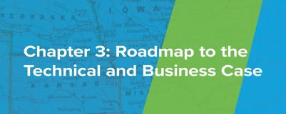
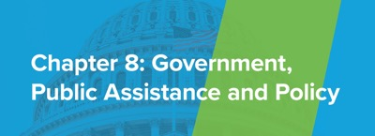




Resilience Incentivization Roadmap 2.0

Slide 35
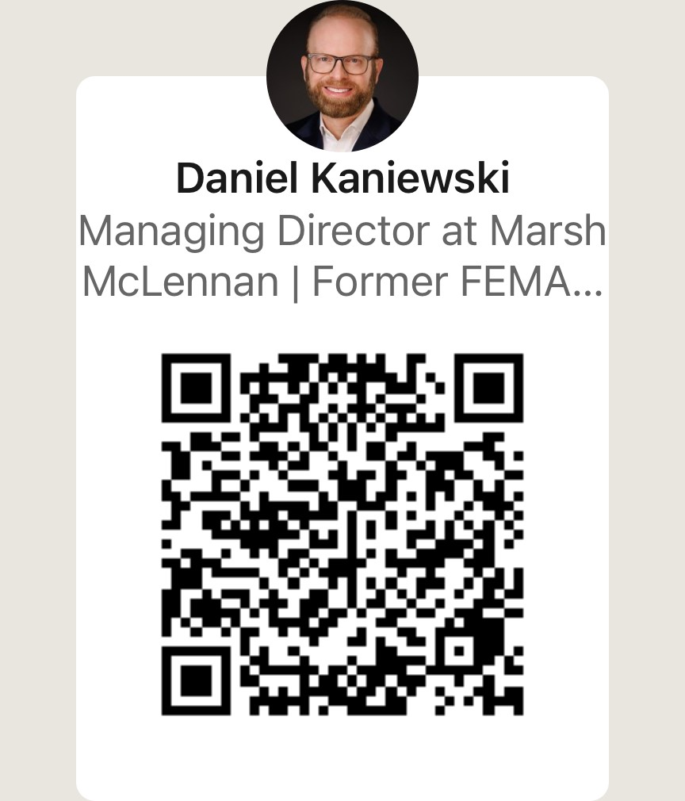
Daniel Kaniewski, Ph.D.
The Disasters that Define Us: https://www.linkedin.com/pulse/disasters-define-us-daniel-kaniewski/

